Slide 1

Data Types and Basic Operations
Asst. Prof. Dr. Derya BİRANT

Slide 2
OUTLINE
Variables
Assignment Statements
Data Types
Input / Output Statements
Comments
Aritmetic Operators
Examples

Slide 3

Variables
A variable denotes a data object to be used in a computation
Every variable has a name, a type, a size and a value

Slide 4
Variable Names
Variable names can consists of
  Letters (a-z, A-Z)
  Digits (0-9)
  Underscore (_)
Example: Number1, Number2, First_Number, Sum, ...
Don’t use Turkish characters (ö,ü,ğ,ç,ş,ı) in variable names.
Case sensitive (sum and Sum are different variables)

Slide 5
Variables
Which components are variables in the following flowchart?
Start
Read (A)
Read (B)
A, B, C, Average
Read (C)
Average = (A + B + C) / 3
Write Average
End

Slide 6
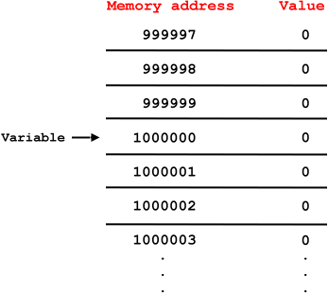
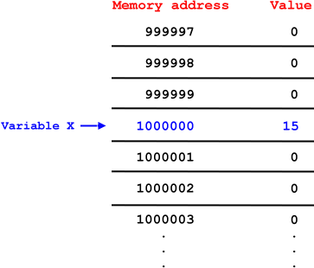
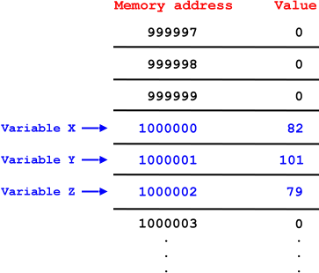
Variables
Each variable name corresponds to location in memory
int x;
int y;
int z;
x = 15;
x = 82;
y = 101;
z = 79;
int x;
x = 15;

Slide 7
Assignment Statements
When new value is placed into a variable, replaces previous value
A← 5
B ← 10
C← A + B
A
B
C
?
?
?
5
?
?
5
10
?
5
10
15

Slide 8
Assignment Statements
Finding hypotenuse of a rigth triangle
A ← 3
B ← 4
C ← √ A² + B²
A
B
C
?
?
?
3
?
?
3
4
?
3
4
5

Slide 9
Assignment Statements
Moving a variable value to another variable
A ← 3
B ← 4
A ← B
A
B
?
?
3
?
3
4
4
4

Slide 10
Assignment Statements
Moving a variable value to another variable
A ← 3
B ← 4
A ← A + B
A
B
?
?
3
?
3
4
7
4

Slide 11
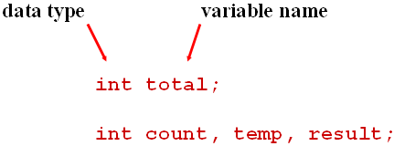
Variable Definition in C#
int i = 123;
  double pi = 3.14;
  char ch = ‘A’;
  string s = “I am a string”;
  bool flag = true;
i
123
pi
3.14
ch
A
s
I am a string
flag
true

Slide 12
Data Types
C# | Signed | Memory | Range
Sbyte | Yes | 1 byte | –128 ... 127
Short (Int16) | Yes | 2 bytes | –32.768 ... 32.767
Int (Int32) | Yes | 4 bytes | –2.147.483.648 ... 2.147.483.647
Long (Int64) | Yes | 8 bytes | –9.223.372.036.854.775.808 .. 9.223.372.036.854.775.807
Byte | No | 1 byte | 0 ... 255
Ushort | No | 2 bytes | 0 ... 65535
Uint | No | 4 bytes | 0 ... 4294967295
Ulong | No | 8 bytes | 0 ... 18.446.744.073.709.551.615
Float | Yes | 4 bytes | -3.402823e38 .. 3.402823e38
Double | Yes | 8 bytes | -1.79769313486232e308 .. 1.79769313486232e308
Decimal | Yes | 12 bytes | -79228162514264337593543950335 .. 79228162514264337593543950335
Char |  | 2 bytes | Unicode characters
boolean |  | 1 byte | True or false

Slide 13
Assignment Statement in C#
Variable values can be changed by using “=“ operator
int A;
int B;
int C;
A = 5;
B = 10;
C = A + B;
A
B
C
?
?
?
5
?
?
5
10
?
5
10
15

Slide 14
Assignment Statement in C#
Variable values can be changed by using “=“ operator
int A;
int B;
double C;
A = 3;
B = 4;
C = Math.Sqrt(A * A + B * B);

Slide 15
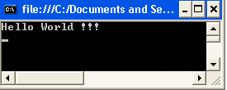
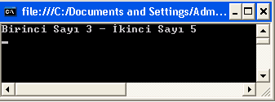
Output Statements
Console.WriteLine: Writes the current line as an output and moves the cursor to the next line.
Example 1:
Example 2:
Console.WriteLine("Hello World !!!");
int A;
int B;
A = 3;
B = 5;
Console.WriteLine("Birinci Sayı " + A + " - İkinci Sayı " + B);

Slide 16
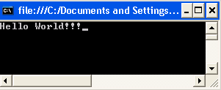
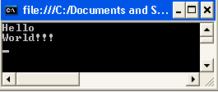
Output Statements
Console.Write: Writes the current line as an output and cursor stays at the same line
Example1:
Console.Write("Hello ");
Console.Write("World!!!");
Console.WriteLine("Hello ");
Console.WriteLine("World!!!");

Slide 17
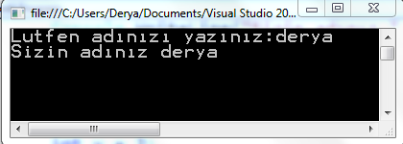
Input Statements
Console.ReadLine: Reads the next line of characters as a string from the user
Example:
name
string name;
Console.Write("Lutfen adınızı yazınız:");
name = Console.ReadLine();
Console.WriteLine("Sizin adınız " + name);
?
derya

Slide 18
Input Statements
Console.Read: Reads the next character from the user
char ch;
Console.Write("Lutfen bir karakter giriniz:");
ch = Convert.ToChar(Console.Read());
Console.WriteLine("Girdiginiz karakter " + ch);

Slide 19
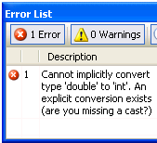
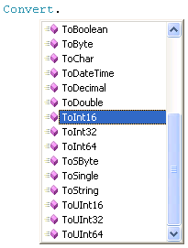
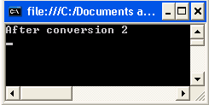
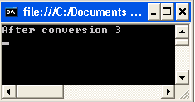
Converting Input Statements
Convert method is used for converting data from one type to other.
double a = 2.6;
int b;
b = a;
double a = 2.4;
int b;
b = Convert.ToInt16(a);
Console.WriteLine("After conversion " + b);
double a = 2.6;
int b;
b = Convert.ToInt16(a);
Console.WriteLine("After conversion " + b);

Slide 20
Input Statements
int number;
double price;
bool flag;
char ch;
number = Convert.ToInt16(Console.ReadLine());
price = Convert.ToDouble(Console.ReadLine());
flag = Convert.ToBoolean(Console.ReadLine());
ch = Convert.ToChar(Console.ReadLine());
Console.WriteLine("Sayı " + number + " Fiyat " + price +
" Mantıksal " + flag + " Karakter " + ch);

Slide 21
Comments
Comments ignored during program execution
  Describes code and provides code readability
Comments in C#:
  Single line command //
  Multiple line command /* .... */
  // Comment a single line
  /* Comment
  multiple
  lines
  */

Slide 22
Aritmetic Operators
C# operation | Arithmetic operator
Addition | +
Subtraction | –
Multiplication | *
Division | /
Remainder | %
double number1 = 5;
double number2 = 2;
Console.WriteLine("Toplama " + (number1 + number2));
Console.WriteLine("Çıkarma " + (number1 - number2));
Console.WriteLine("Çarpma " + number1 * number2);
Console.WriteLine("Bölme " + number1 / number2);
Console.WriteLine("Mod alma " + number1 % number2);

Slide 23
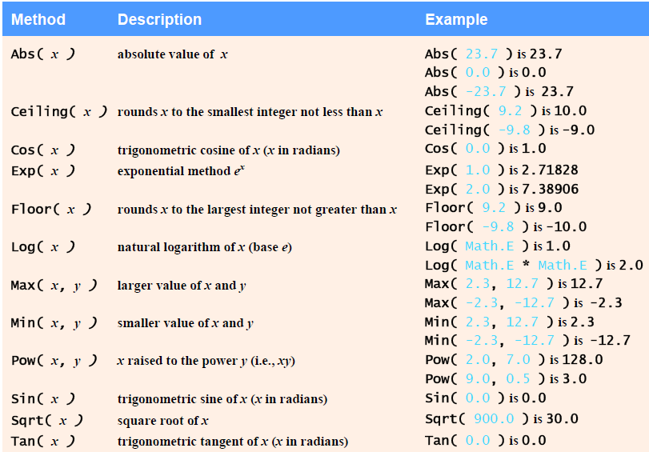
Mathematical Functions

Slide 24
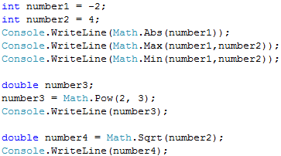
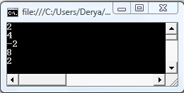
Mathematical Functions

Slide 25
Random Number
Generating a number between 1 and 6 randomly.
Random random = new Random();
int number;
number = random.Next(1, 7);
Console.WriteLine(number);

Slide 26

Example 1
Finding area of a field
Start
length
width
Read (width)
int width, length, area;
Console.Write("Enter the width of field: ");
width = Convert.ToInt32(Console.ReadLine());
Console.Write("Enter the length of field: ");
length = Convert.ToInt32(Console.ReadLine());
area = width * length;
Console.WriteLine("The area of the field " + area);
Console.ReadLine();
Read (length)
area = width * length
Write Area
Stop

Slide 27
Algorithm and Program
Algorithm (in textual and graphical)
Start
Algorithm FieldArea
Input: The width and length of the field.
Output: The area of the field.
Read width, length
area = width * length
Write Area
End Algorithm
Read (width)
Read (length)
area = width * length
Write Area
Program
Stop
int width, length, area;
Console.Write("Enter the width of field: ");
width = Convert.ToInt32(Console.ReadLine());
Console.Write("Enter the length of field: ");
length = Convert.ToInt32(Console.ReadLine());
area = width * length;
Console.WriteLine("The area of the field " + area);
Console.ReadLine();

Slide 28
Question
Write C# code of the following algorithm.
Start
Read (A)
Read (B)
Read (C)
Average = (A + B + C) / 3
Write Average
End

Slide 29
Example 2
Write a program that converts the temperature value given in Centigrade (°C) degree to Fahrenheit (°F)
F = 9/5C +32
double centi;
double fahri;
Console.WriteLine("Please enter degree in C");
centi = Convert.ToDouble(Console.ReadLine());
fahri = 9.0 / 5.0 * centi + 32.0;
Console.WriteLine("Result degree in F " + fahri);

Slide 30
Example 3
Take the grades of the student for each component and then calculate her/his course grade.
%25 MidtermExam %25 Assignment %50 FinalExam
double midtermexam, assignment, finalexam, grade;
Console.WriteLine("Please enter midterm exam grade:");
midtermexam = Convert.ToDouble(Console.ReadLine());
Console.WriteLine("Please enter assignment grade:");
assignment = Convert.ToDouble(Console.ReadLine());
Console.WriteLine("Please enter final exam grade:");
finalexam = Convert.ToDouble(Console.ReadLine());
grade = midtermexam * 0.25 + assignment * 0.25 + finalexam * 0.5;
Console.WriteLine("Grade = " + grade);

Slide 31

Question
Write a program that computes the area of the red doughnut?
Example:
Inputs: R1 = 6 R2 = 2
Output: 100.48

Slide 32
Solution
int radius1, radius2;
double area;
Console.Write("Enter the radius of big circle: ");
radius1 = Convert.ToInt32(Console.ReadLine());
Console.Write("Enter the radius of small circle: ");
radius2 = Convert.ToInt32(Console.ReadLine());
area = (3.14 * radius1 * radius1) - (3.14 * radius2 * radius2);
Console.WriteLine("Result = " + area);

